Slide 1



DYNAMIC LINK

Slide 2
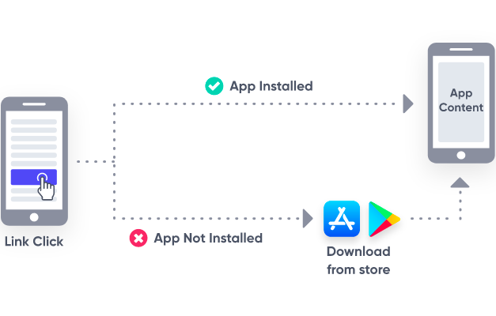
What is Deep Link / Universal Link ?

Slide 3
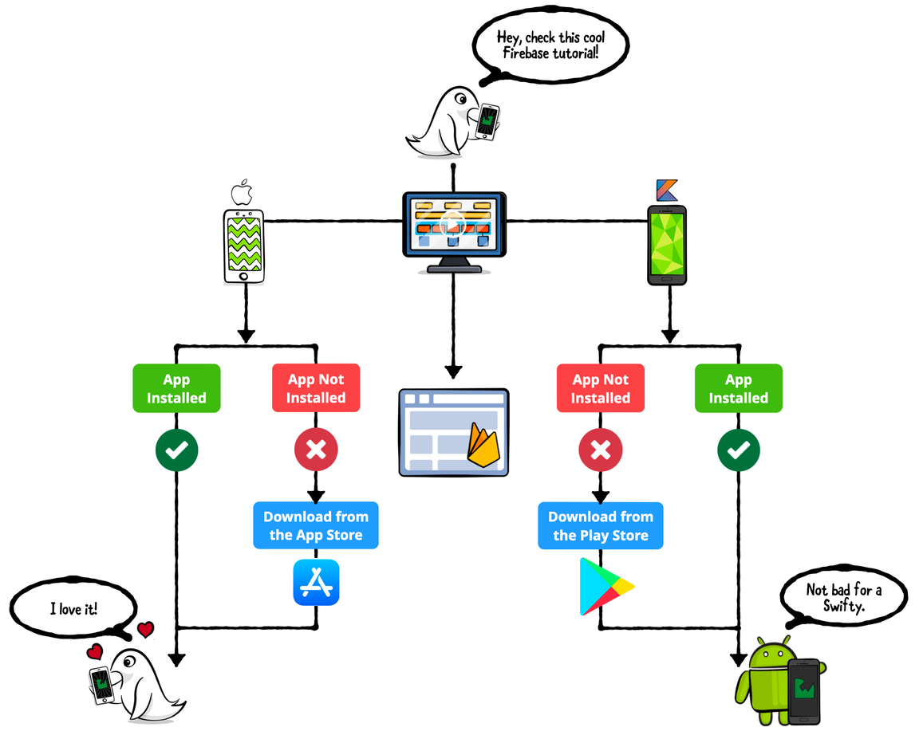

What is Dynamic Link ?

Slide 4
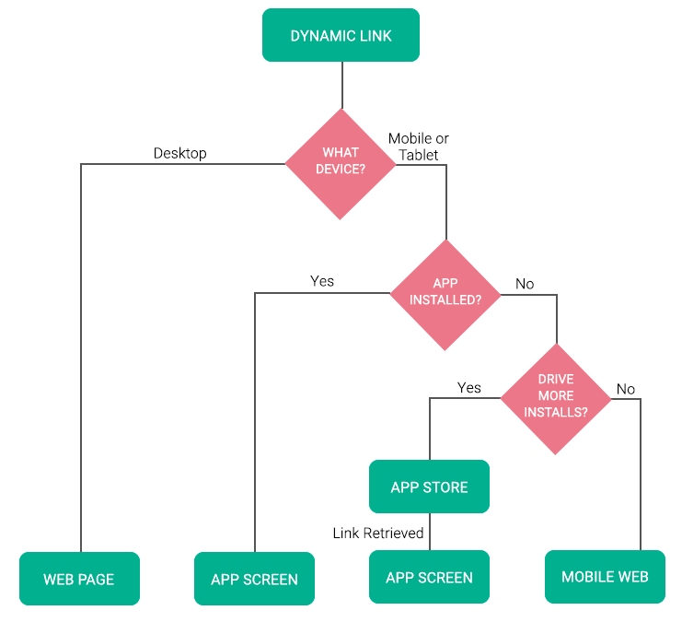
What is Dynamic Link ?

Slide 5
Dynamic Link Structure
https://siravich.page.link/6VEnEu4GpFJXXyJ96
Dynamic Link URL
Deep Link URL
https://siravich.page.link/men-page?category=shirt

Slide 6
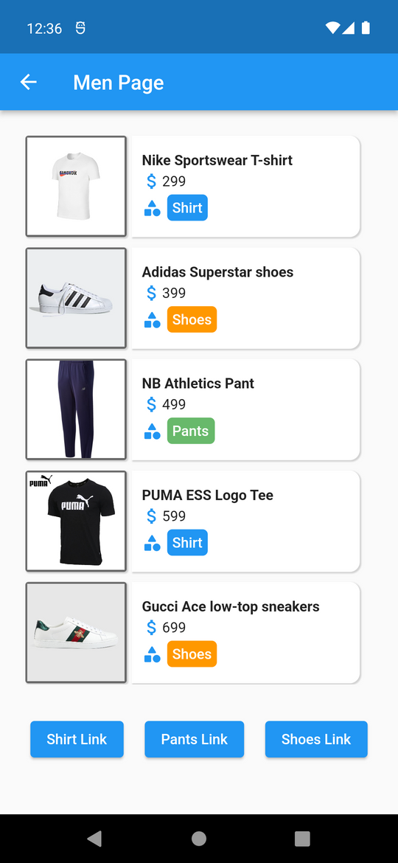
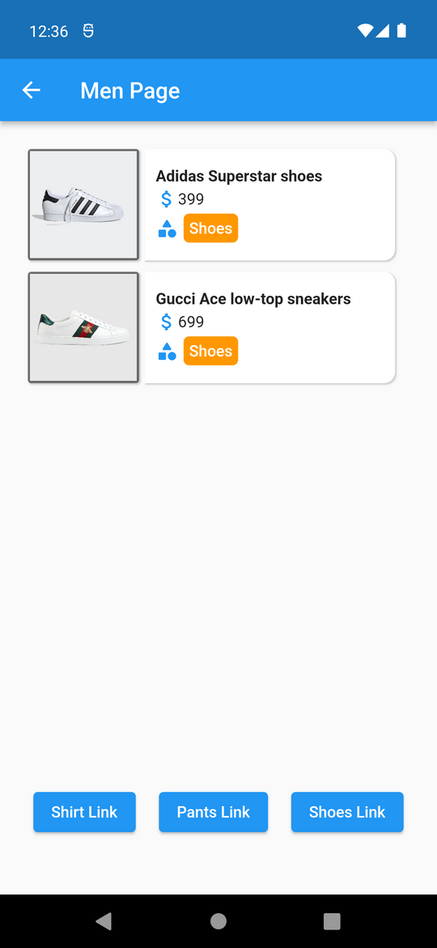
https://siravich.page.link/men-page?category=shoes

Slide 7
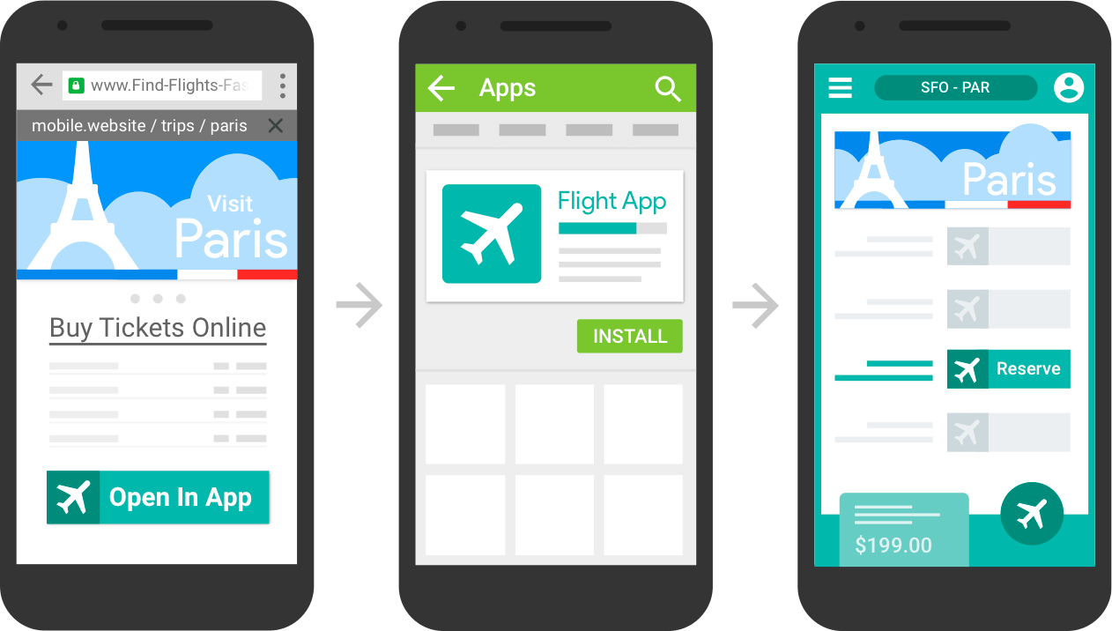
USE CASE
BUY TICKETS ONLINE

Slide 8
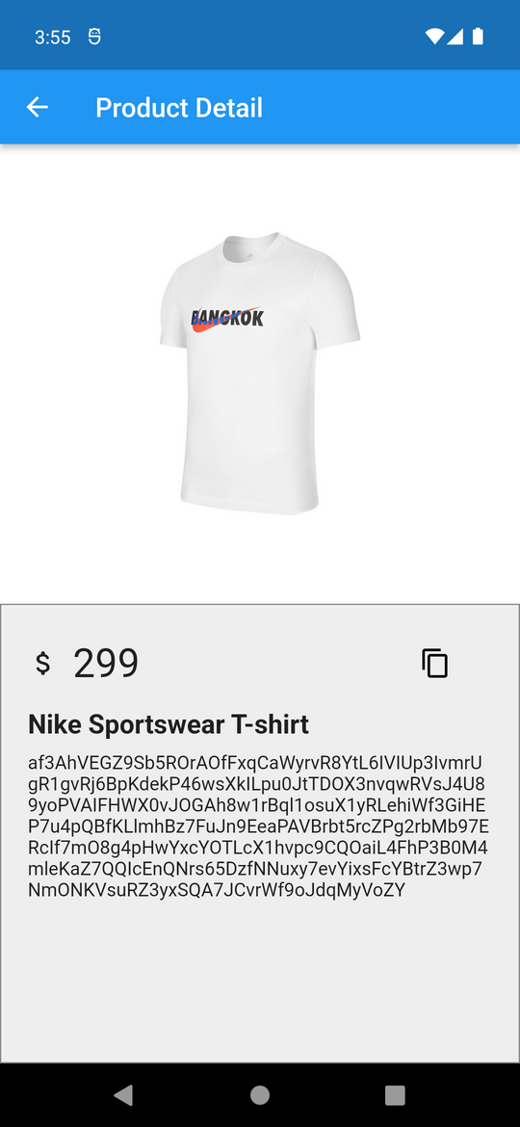
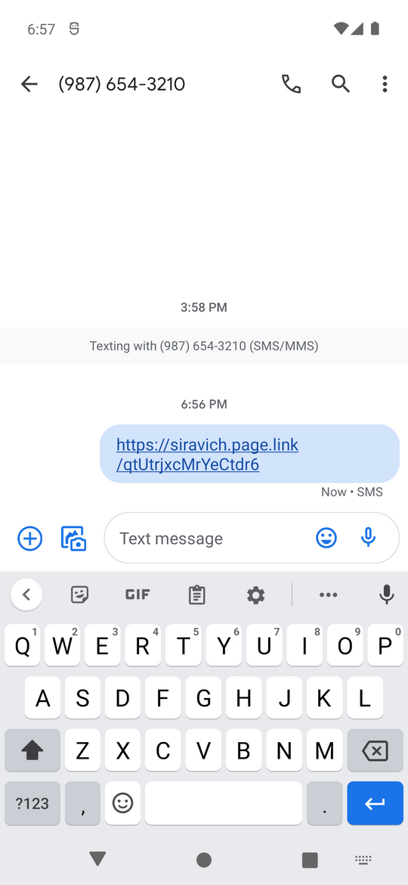

USE CASE
USER-TO-USER SHARING
COPY
SEND

Slide 9


Create Dynamic Link
Firebase Console
Programming

Slide 10
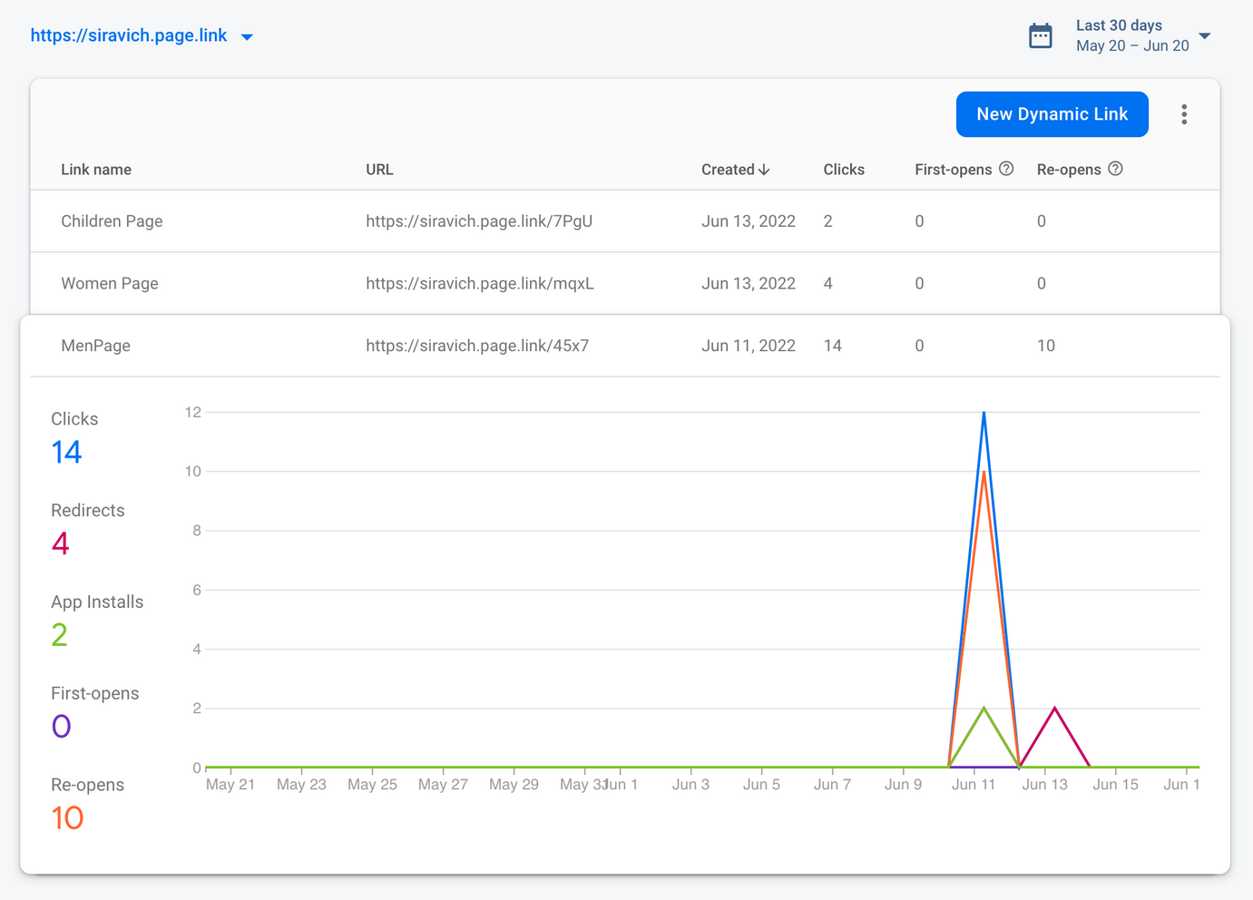
Create Dynamic Link #1
Firebase Console

Slide 11
Create Dynamic Link #2
Programming
Builder API
REST API
( IOS , Android )
( Web , ... )

Slide 12

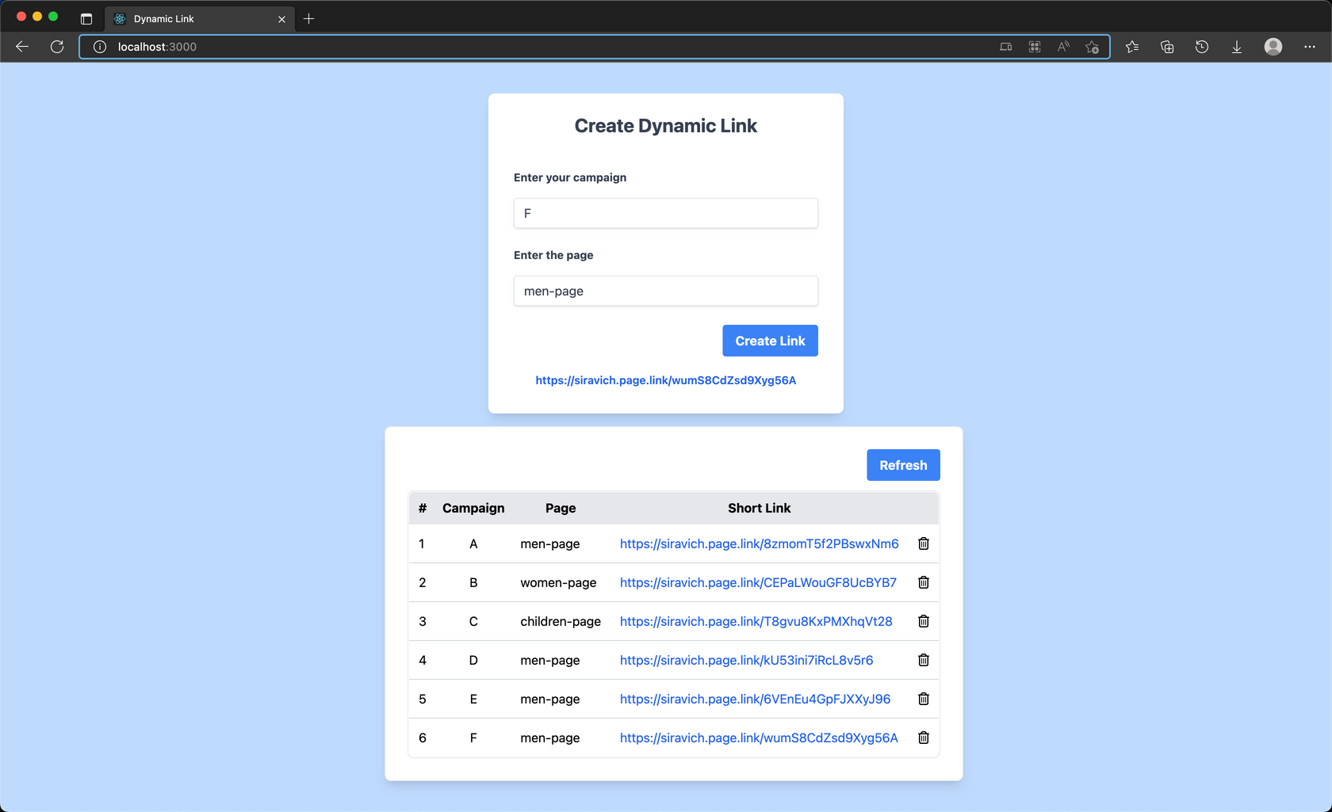
DEMO

Slide 13
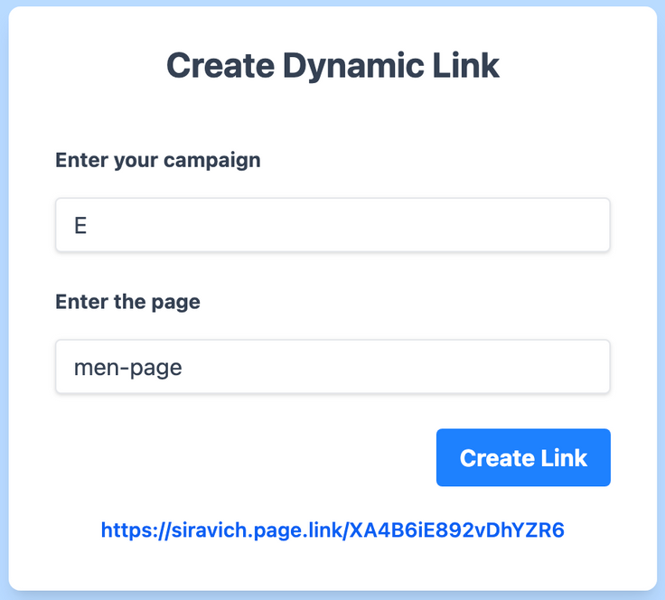
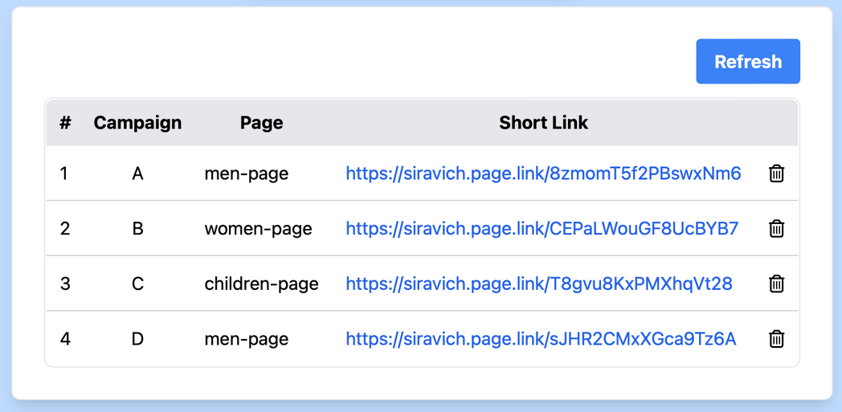
DEMO
CLOUD FIRESTORE

Slide 14
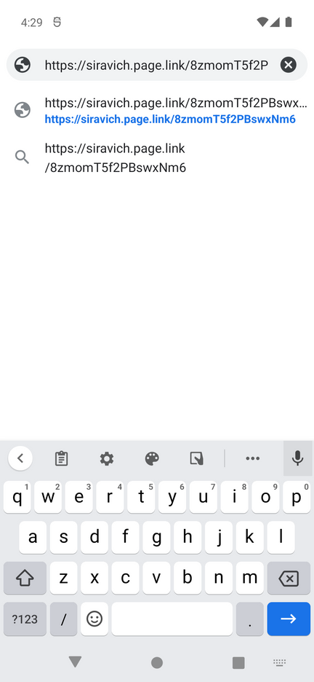
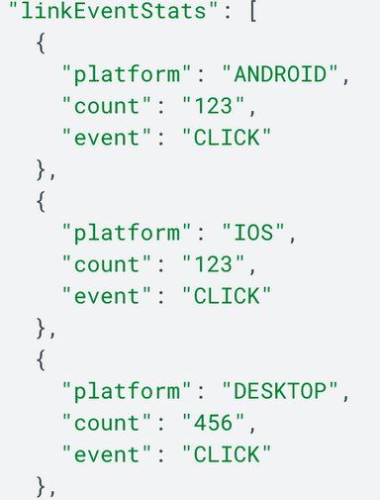
DEMO
TEST DYNAMIC LINK
VIEW ANALYTICS DATA

